Slide 1
HTML FOR BEGINNER
HYPER TEXT MARKUP LANGUAGE

Slide 2
APA ITU HTML?
HYPER TEXT MARKUP LANGUAGE
MARKUP LANGUAGE/WEB LANGUAGE
FRONT END TECHNOLOGY

Slide 3
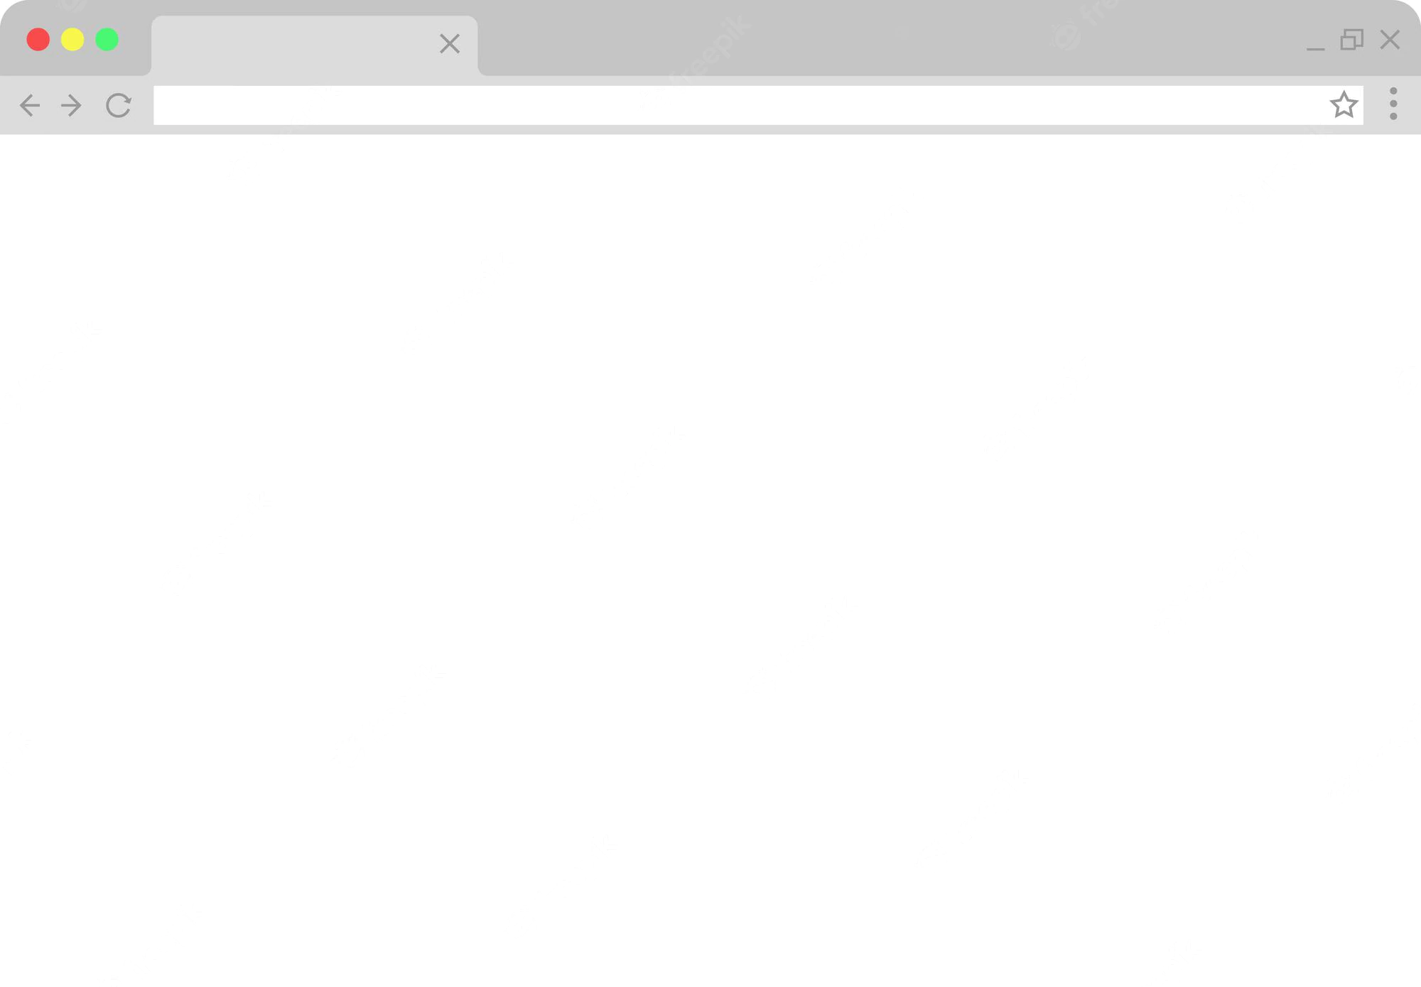
HTML STRUCTURE
<html>
<head>
<title></title>
</head>
<body>
</body>
</html>

Slide 4
Format Element HTML!
<tag>..kandungan..</tag>

Slide 5
Basic Element
Element/tag Name | Description
<h1> - <h6> | Heading
<p> | paragraph
<strong> or <b> | bold
<em> or <i> | italic
<Ins> or <u> | underline

Slide 6
element without a closing tag
Element/Tag Name | Description
<br> | Line Break
<hr> | Horizontal line

Slide 7
Link Format
Tag
<a href=“url”>hypertext link</a>
Attribute

Slide 8
Image Format
Mandatory
<img src=“…” width=“..” height=“..” align=“..”>
Optional

Slide 9
List Format
Unordered List
List 1
List 2
List 3
Ordered List
List 1
List 2
List 3

Slide 10
Unordered List
<ul>
<li>...</li>
<li>...</li>
</ul>

Slide 11
Ordered List
<ol type=‘’a’’>
<li>...</li>
<li>...</li>
</ol>
Attribute Tag ol:
type=“a”
type=“A”
type=“i”
type=“I”

Slide 12
Table Format
tr: Table Row
th: Table Heading
td: Table Data
<table border="1">
<thead>
<tr>
<th>NAME</th>
<th>CITY</th>
<th>ID NUMBER</th>
</tr>
</thead>
<tbody>
<tr>
<td>Arjuna</td>
<td>Kuala Lumpur</td>
<td>1337</td>
</tr>
</tbody>
</table>
NAME | CITY | ID
Arjuna | Kuala Lumpur | 1337

Slide 13
Iframe Format
<iframe src=“url" width=“.." height=“..“ align=“..”></iframe>

Slide 14
Form Format
<form>
...
elemen Form
...
</form>

Slide 15
Form Element
Element & Attribute | Description | Extra Attribute
<input type="text" > | Text Box | placeholder=“..”
<input type="checkbox" > | Check Box | Checked
<input type="radio" > | Radio Button | name=“..”
<textarea></textarea> | Text Area | rows=“..” cols=“..”
<select> <option></option> <option></option> </select> | Drop Down | Selected
<button type="submit"></button> | Submit Button

